Slide 1
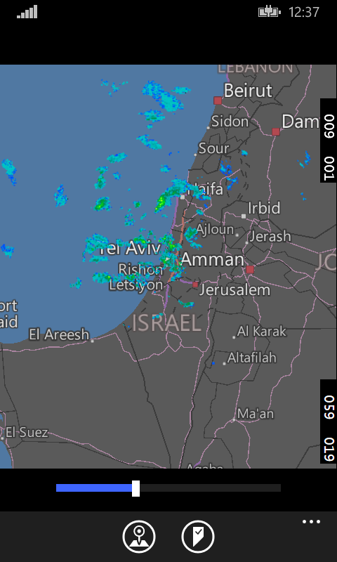
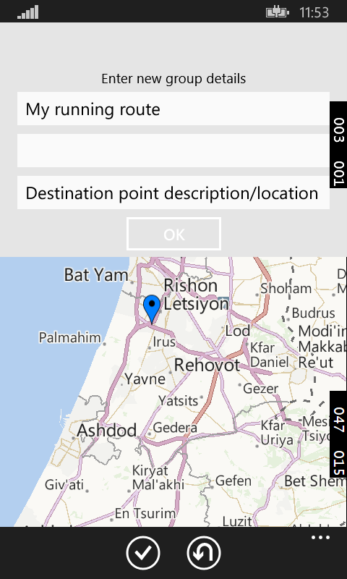
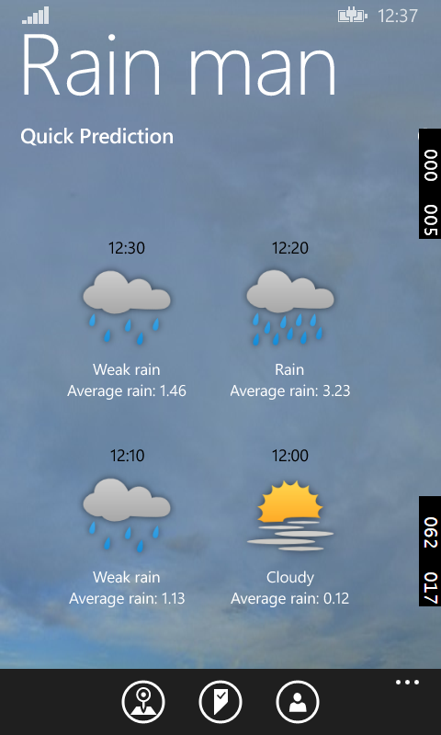
Rain Man
Shachar Pooyae
Denis Golyanov
David Lifshiz

Slide 2
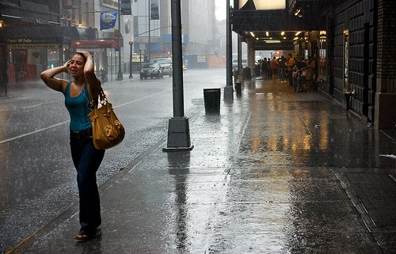
Motivation
During rainy days, it is a common annoyance to wait for exactly the right time to leave the house in order to avoid the rain, or at-least, reach the destination not entirely wet. People who rely heavily on bicycles, motorcycles and walking on foot to reach their destination, often have a hard time figuring the best time to leave the house, and often find out that it was a bad idea not to wait 10 more minutes. Our app will provide a solution to these problems. No longer will the user have to guess, or rely on his understanding of rain-radar maps, to decide when to leave, and how.

Slide 3
The features of our app:
- The user will have a rain strength indicator for 10, 20 and 30 minutes at his location or at other specified location.
-Our application will provide a convenient platform to create, save and edit custom paths.
- The user will be able to view the water prediction levels on each path and to choose whether to start taking the path now, or in 10, 20 or 30 minutes.
- The user will be able to determine the way in which he travels - by a car, by a motorcycle, by a bike or by walking.
- The app will calculate an average raining amount level on each path, presenting the finds to the user. The app will also suggest which path among these paths should he take, when will he reach his destination, and when should he leave the house.
- The app will provide an interface to check the estimated amount of water that rained over a given area, up to 30 days back.

Slide 4
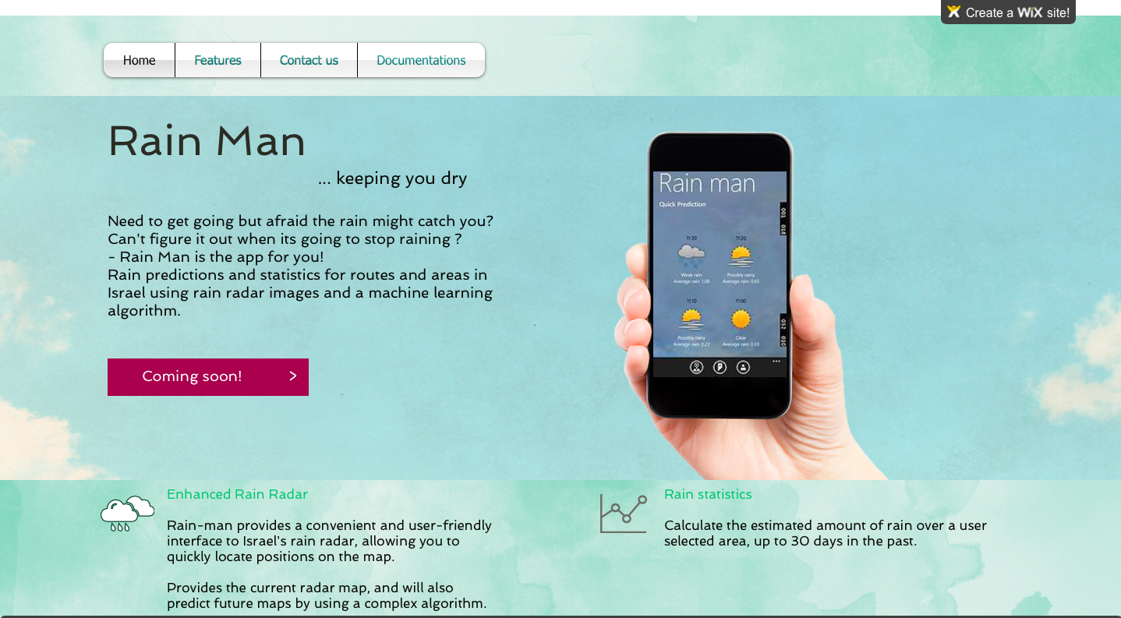
Our webise:
http://davidl24.wix.com/rainman

Slide 5
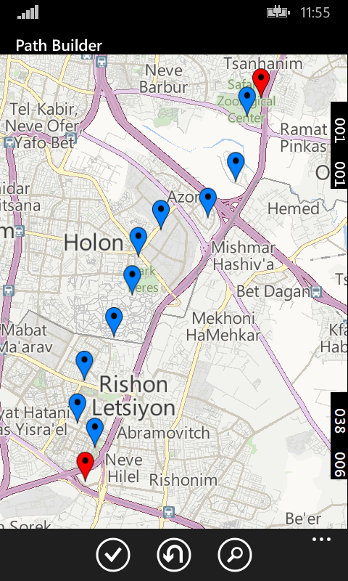
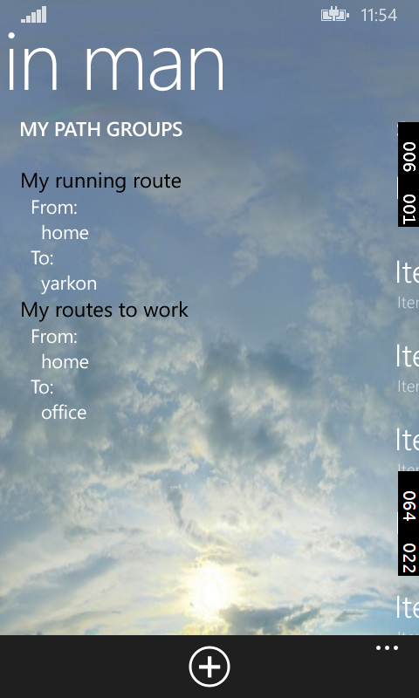
Let's watch a demo video of the app..

Slide 6
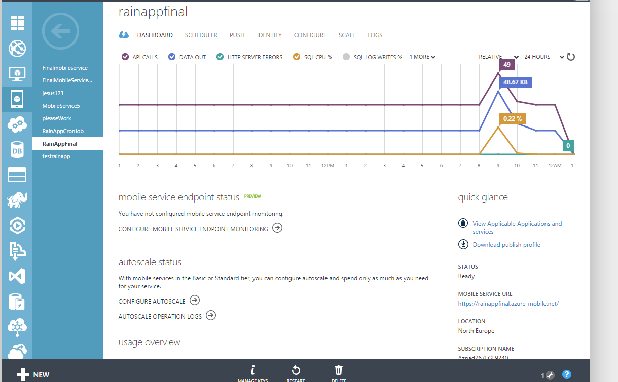
Technologies:
For the server side:
We use a mobile service to accommodate to following needs:
Maintain the tables for the application which include the paths, the user info, etc.
API’s for the client. For example, an API for calculating the total amount of rain that poured over specific area over a period of time
Download pictures form the IMS and insert them to the Blob storage,
using Scheduled Jobs
4. Provide a convenient way of authorizing clients (Facebook/Google)

Slide 7
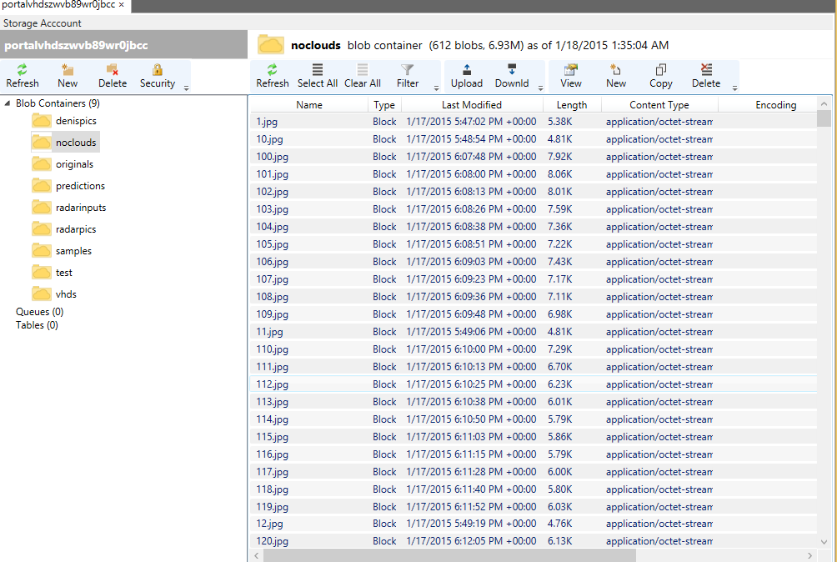
Blob Sorage:
This is our main storage for storing the images. We use it from the Linux VM and from the mobile service. It can handle images much better than the table storage or the SQL DB.

Slide 8

Services:
connection between VM and blob service with a known library
-image processing :
radar off
-image processing : black dots (neighbors median hsv) , difference to
-location to pixel:
-pixel matching between two picture
-pixel to color :
-hue (360 degrees.)
-two Continuous hue parts in the original bar.
-linear between delimiters assumption ,

Slide 9
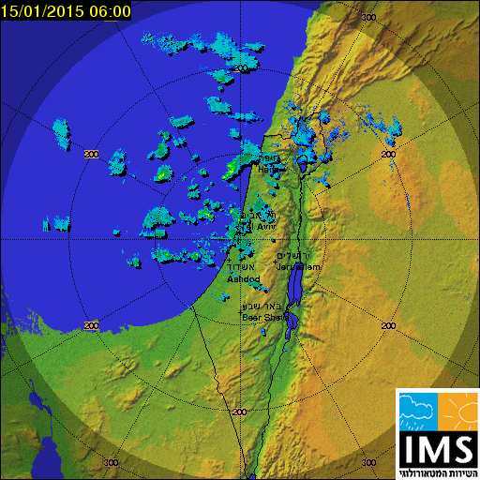

Slide 10
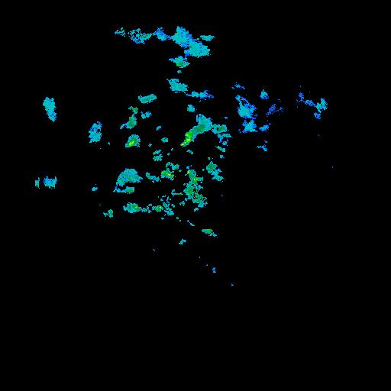

Slide 11
UI

Slide 12
Challenges:
Some of us needed to upgrade windows (or virtual machines).
Getting familiar with the azure infrastructure: numerous videos and articles.
Deciding the type of tables to use ( Blob, Table storage and SQL DB).
Accessing the DB with bugs in stream and Little Endean or Big Endean differences.
Coordination between the 3 team mates.
Source Control (GIT).
No help regarding the use of AZUR: we contacted Microsoft help desk.
Almost no documentation regarding the python library for azure
Human directed radar scale
Bad connection with the radar site
The radar map is a “flat” map and the earth is a glob

Slide 13

STOPPERS
1. No “Black Box” for computing the prediction images.
David has spent a month trying to install the program with no success.
Numerous Emails to Ben couldn’t lead us to the solution.
Prof. Wolf is trying to help us and one of his Master student is trying to install the prediction program on Azur.
2. Facebook logging is not working (crashes) when trying it on a real device.

